Slide 1
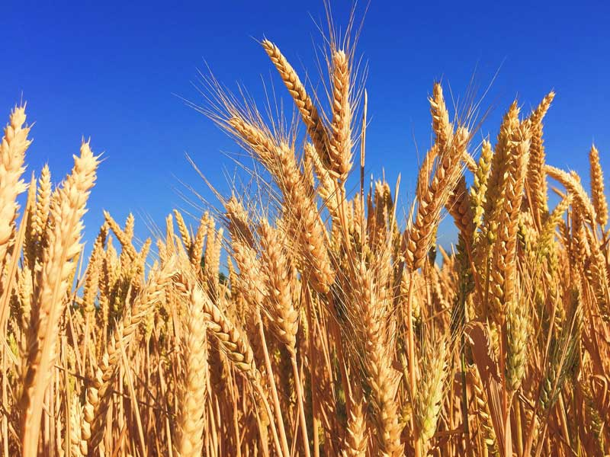
Crop Production Analysis in India

Slide 2
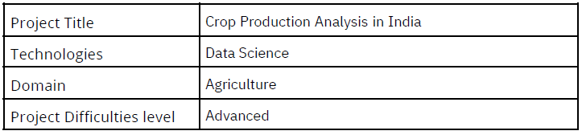
Project Detail

Slide 3
Background
The Agriculture business domain, as a vital part of the overall supply chain, is expected to highly evolve in the upcoming years via the developments, which are taking place on the side of the Future Internet. This paper presents a novel Business-to-Business collaboration platform from the agri-food sector perspective, which aims to facilitate the collaboration of numerous stakeholders belonging to associated business domains, in an effective and flexible manner.
This dataset provides a huge amount of information on crop production in India
ranging from several years. Based on the Information the ultimate goal would be to
predict crop production and find important insights highlighting key indicators and
metrics that influence crop production.

Slide 4
Problem Statement
Crop production is a crucial component of India's agricultural sector, playing a vital role in the country's economy and providing livelihoods to millions of farmers. This project aims to analyze and understand the dynamics of crop production in India, considering various factors that influence this sector's performance. The analysis includes a comprehensive study of major crops, agro-climatic zones, production practices, and the impact of external factors such as monsoon, government policies, and market demand.The objective of the project is to perform data visualization techniques to understand insights of the data. This project aims apply various Business Intelligence tools such as Tableau or Power BI to get a visual understanding of the data.

Slide 5
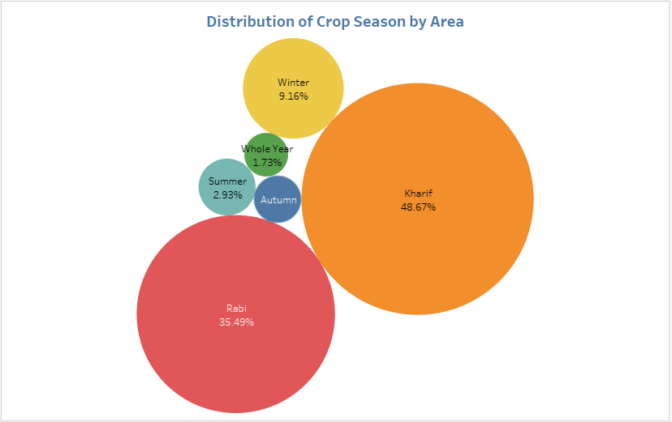
Insights

Slide 6
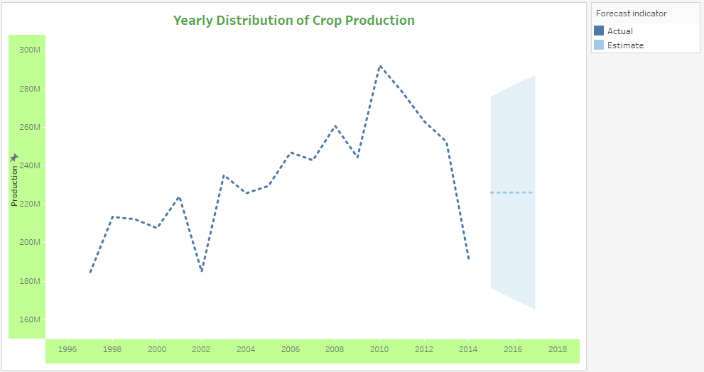
Yearly Distribution of Crop Production

Slide 7
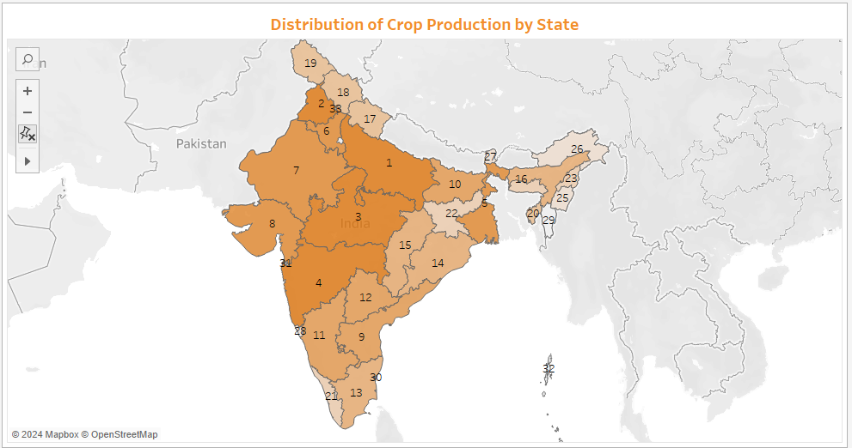
Distribution of Crop Production by State

Slide 8
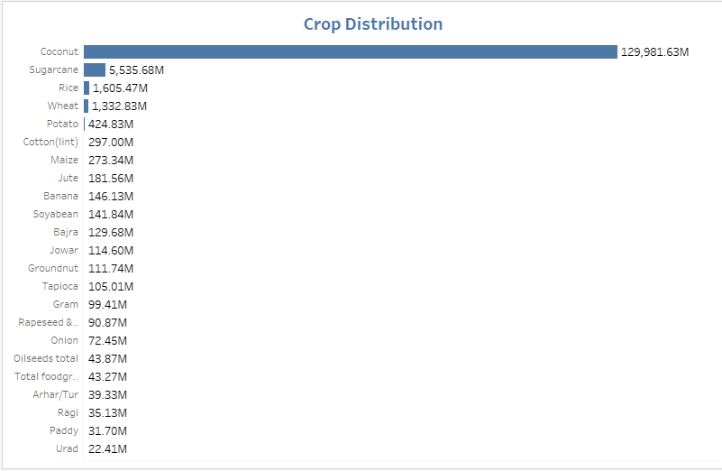
Crop Distribution By production

Slide 9
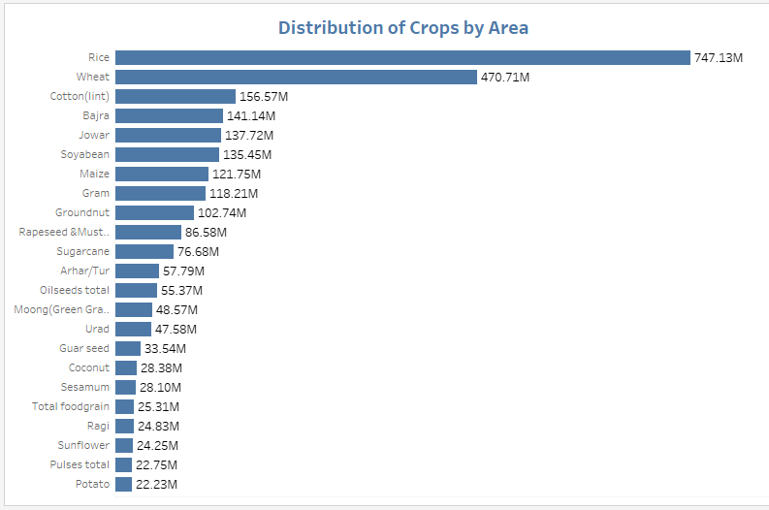
Distribution of Crops by Area

Slide 10
Conclusion
48.67%of area under were belong to Kharif crop season
In 2011, highest amount of crop production were yielded
Uttar Pradesh is ranked number 1 in overall crop production
Coconut is the most produced crop
Rice, Wheat & Cotton are the top 3 crops by area

